Slide 1

DHOLE PATIL COLLEGE OF ENGINEERING, PUNE. DEPARTMENT OF MECHANICAL ENGINEERING
B.E. Mechanical
Project Stage – I
TERRORISM
Predicting Terrorist Groups and Future Events
By
Mr. Aditya Shendkar
Mr. Saket Prasad
Mr. Siddharth Naik
Mr. Shubham Chavan
Under the guidance of
Prof. Dattatray Kotkar
DEPARTMENT OF MECHANICAL ENGINEERING
YEAR 2022-23

Slide 2
CONTENT
Abstract
Introduction
Motivation
Workflow
Problem Statement
Dataset Description
Methodology/Our Approach
References

Slide 3
Abstract:
“The threatened or actual use of illegal force and violence by a non-state actor to attain a political, economic, religious, or social goal through fear, coercion, or intimidation.” - GTD.
As a generation, we may not have faced World War I and II. But the events of the past and the present year are testaments to the fact that humankind is still far from “Live and Let Live”. The constant parlay of power grabs, and political, trade, and religious conflicts still suffocate all of us.
Defense against terrorism is difficult because of terrorism's surprise advantage, since we do not know the type, extent, timing or precise location of the next attack. Preventive measures are still the best defense against terrorism.
Hence, this project studies such factors that make an attack successful. Knowing the target region and extent of an attack can be highly useful for saving countless lives. The past and current scenarios can be examined with the aid of data visualization. Further, we aim to predict the target region of an attack and whether or not an attack will be successful with the help of various machine learning and deep learning models.

Slide 4
Introduction
World peace was one of the core reasons for forming the United Nations organization. Terrorism is the biggest hurdle to world peace. Terrorism is commonly ignored by the civilians who are not affected directly by the dangers. For the most part, terrorism is considered unpredictable and unfortunate calamity that strikes some parts of the world more than others. Based on the location of the events, people at large have very limited information about any such event happening in other parts of the world and hence react differently. In this project, we focus on terrorism by analyzing the dataset provided by START (Study of Terrorism and Response to Terrorism) Consortium to explore meaningful patterns and statistics. Terrorism is an unsettled term. Currently, the General Assembly of the United Nations is unable to agree on a single definition of terrorism. Because of this difficulty, different governments and organizations define terrorism in their own way. This confusion creates multiple conflicts about which events are considered under terrorism and which are not. Different organizations construct their own definition of terrorism and operate accordingly. As a result, there could be a reasonable difference in the contents of terrorismrelated datasets collected by independent organizations. Hence, analyses and results provided in this study might vary with the similar analyses done on a different dataset

Slide 5
Motivation:
Python : Pandas, NumPy, Matplotlib, Seaborn, scikit-learn, Anaconda, Jupyter
Terrorism:
Cowardly act inflicted on the innocent
GTD:
Global Terrorism Database maintained by START
Process Lifecycle:
Data cleansing, EDA, Visualizations, Feature Engineering, Machine Learning

Slide 6
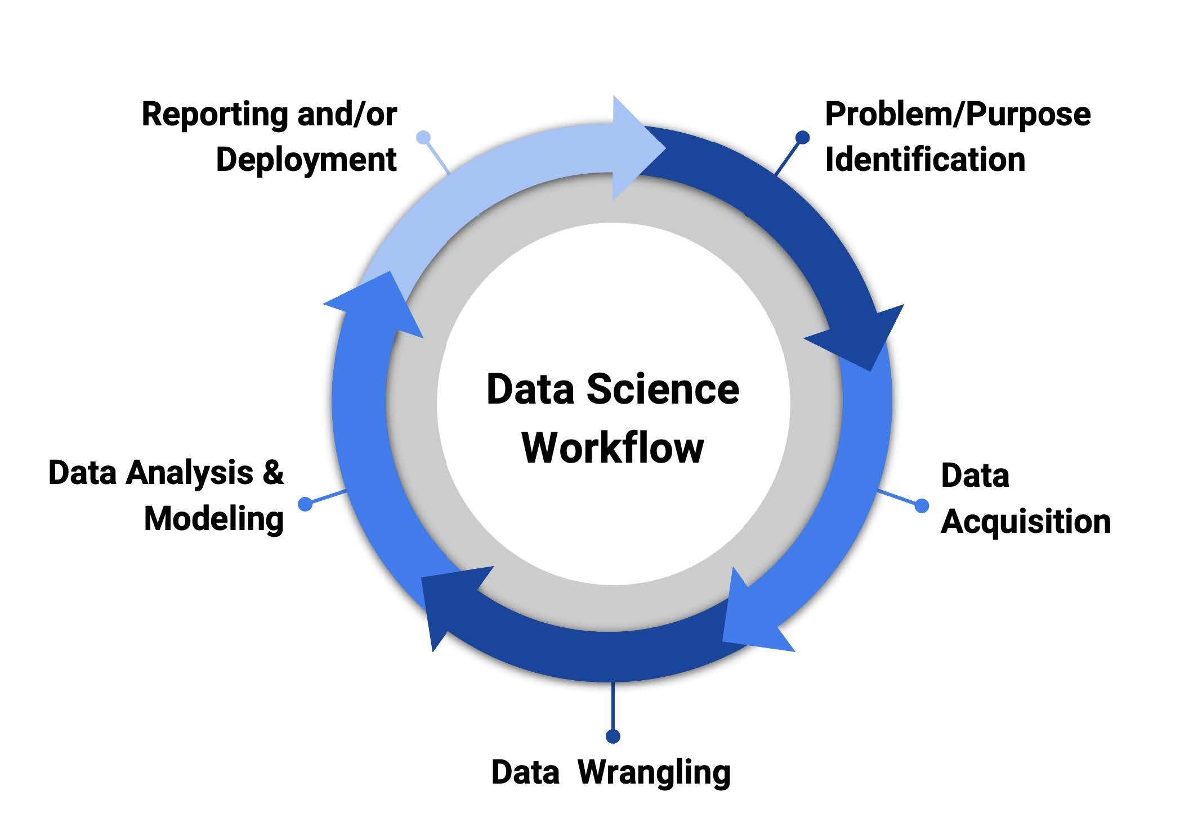
Workflow

Slide 7
Problem Statements:
Defense against terrorism is difficult because of terrorism's surprise advantage, since we do not know the type, extent, timing or precise location of the next attack. Preventive measures are still the best defense against terrorism. It would be a great advantage to know which region might be the target of an attack. This knowledge could save countless lives. To this end, we have decided to give our project the following missions:
1)Prediction of a successful attack
2)Prediction of target region of an attack

Slide 8
Dataset Description
This dataset consists of 181691 rows and 135 columns containing information about various terrorist attacks across the world over a period of 1970 to 2017, except 1993. The large number of columns includes information about location, tactics, perpetrators, targets, and outcomes.
Source: https://www.kaggle.com/datasets/START-UMD/gtd

Slide 9
OUR APPROACH
For problem statement 1 – Predicting a successful attack:
A deep learning model (Sequential) has been developed to predict whether an attack will be successful or not. It uses supervised learning to learn the different features responsible for the success of an attack and uses those concepts to predict the success rate for future attacks.
For problem statement 2 – Predicting the target region of a terrorist attack:
Several machine learning ensemble models like Logistic Regression, Random Forest, KNN, etc., have been tested against the dataset to determine the target region of an attack.

Slide 10
Reference
Dataset: https://www.kaggle.com/datasets/START-UMD/gtd
Dataset description: https://start.umd.edu/gtd/
Global Terrorism Index: https://www.visionofhumanity.org/maps/global-terrorism-index/#/
Global Terrorism Index: https://en.wikipedia.org/wiki/Global_Terrorism_Index

Slide 11
Thank You
We will continue our project with data cleaning,
model training and evaluation….

